Slide 1
Lecture 24 Confidence Intervals and Hypothesis Tests Parametric vs. Non-parametric tests The sign test

Slide 2
Review:
What is the relationship between two sided tests and confidence intervals?
Define the following:
Type I error
Type II error
Power

Slide 3
Warm Up:

Slide 4

Parametric Vs. Non-Parametric
Parametric tests – make assumptions about the population distribution from which the data are sampled.
Non-parametric tests – make no explicit/implicit assumptions about the population distribution of $X$

Slide 5
Advantages and Disadvantages of Non-Parametric Statistics
Non-parametric tests:
Advantages
They may be the only alternative when sample sizes are very small (unless the population distribution is known exactly, but this is almost never the case)
They make few assumptions about the population distribution of the data
They are advantages when the data represent crude measurements such as subjective ratings/rankings (e.g, Likert responses)
They often have simpler computations and interpretations than parametric tests
Disadvantages
They are generally less powerful than their parametric analogues

Slide 6
The sign test
The sign test is a type of non-parametric test that is best used for data generated from match paired designs – An experimental design which takes pairs of measurements on each subject, usually once before the treatment and once after the treatment producing a set of paired measurements
The sign test is relatively under-powered compared to the other parametric tests we have learned about. However, it is very flexible and makes almost no assumptions about the data or it’s population distribution

Slide 7


Example- The Sign Test
Ex. ) Consider the following data from a study comparing the ratings of husbands and wives on the perceived relative influence of each member of the couple on a major financial decision. The ratings are made on a 1-7 scale ranging from wife-dominated (1) to husband-dominated (7).

Slide 8
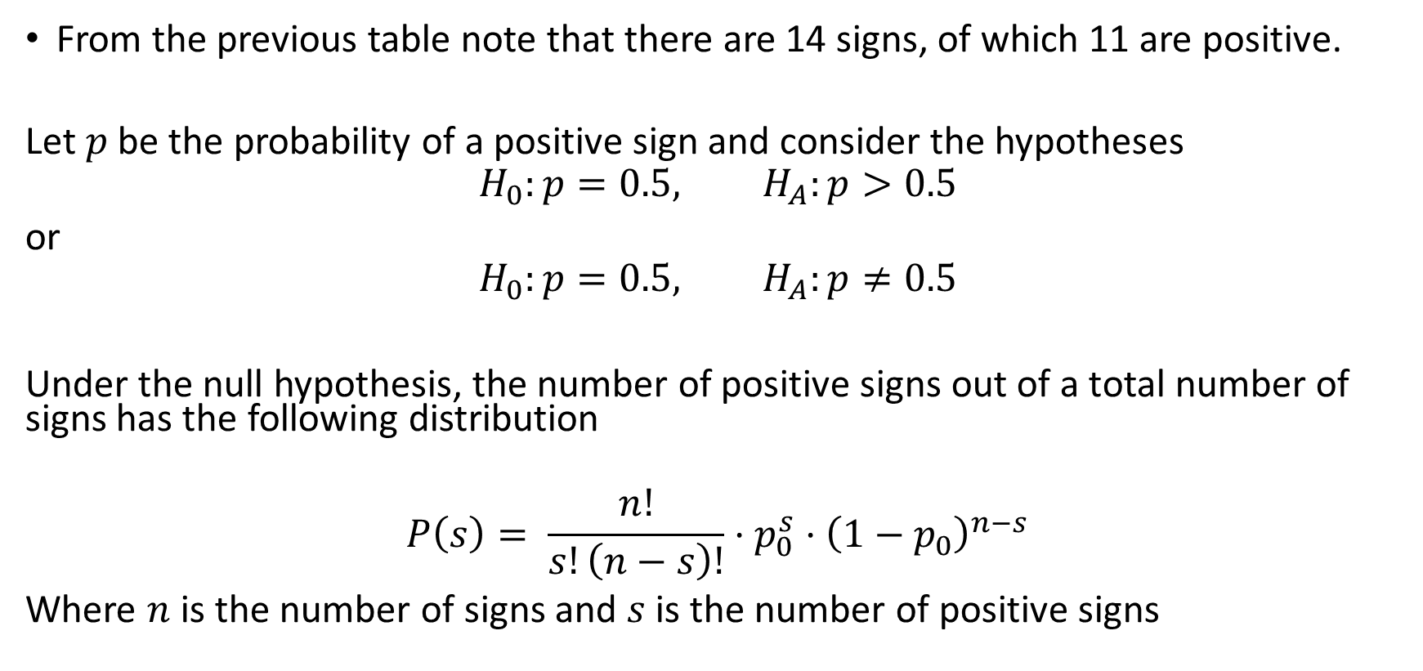
Example- The Sign Test
From the previous table note that there are 14 signs, of which 11 are positive.
Let $p$ be the probability of a positive sign and consider the hypotheses
$$H_{0}:p=0.5, H_{A}:p>0.5$$
or
$$H_{0}:p=0.5, H_{A}:p≠0.5$$
Under the null hypothesis, the number of positive signs out of a total number of signs has the following distribution
$$P\left(s\right)= \frac{n!}{s!\left(n−s\right)!}⋅p_{0}^{s}⋅{\left(1−p_{0}\right)}^{n−s}$$
Where $n$ is the number of signs and $s$ is the number of positive signs

Slide 9
Example- The Sign Test
Compute the probability of getting 11 signs + out of 14 total signs

Slide 10
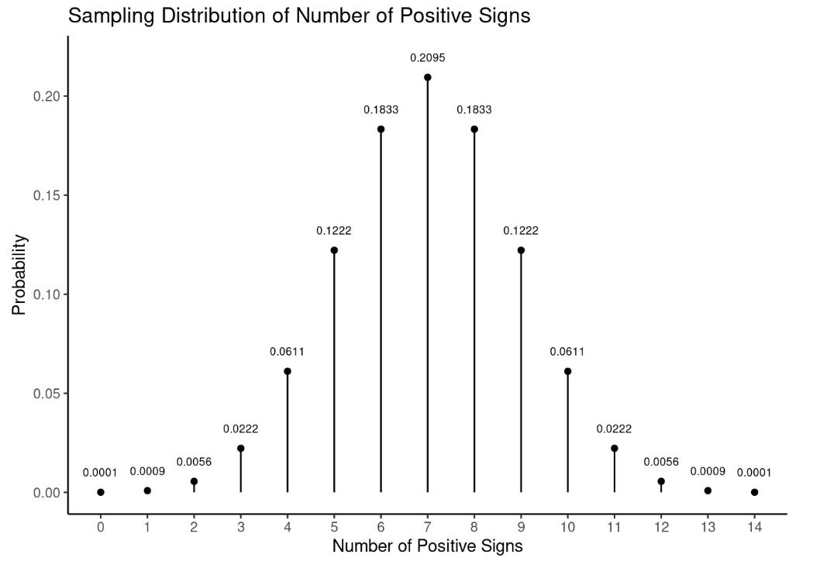

Slide 11
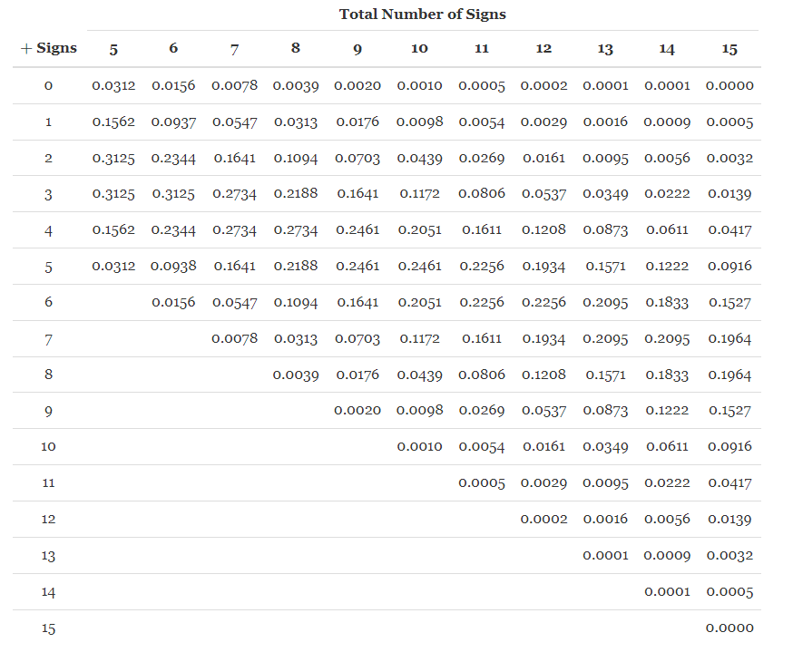

Slide 12
Example 2: The Sign Test
In many states, the title of “Chess Master – X” is given to the students in grade X who rank in the States top 15 chess players in that grade. The 8th grade Chess Masters from New York and Los Angeles play in the U.S Championship. The wins (1), losses (-1), and ties (0) from 15 games appear below
Pair | 1 | 2 | 3 | 4 | 5 | 6 | 7 | 8 | 9 | 10 | 11 | 12 | 13 | 14 | 15
LA | 0 | 1 | 1 | 1 | 0 | 1 | 0 | 1 | 1 | 0 | 0 | -1 | 1 | 1 | 1
NY | 0 | -1 | -1 | -1 | 0 | -1 | 0 | -1 | -1 | 0 | 0 | 1 | -1 | -1 | -1
sign |  | + | + | + |  | + |  | + | + |  |  | - | + | + | +

Slide 13
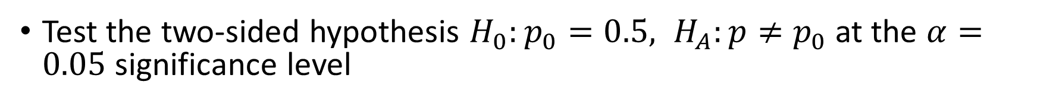
Example 2: The Sign Test
Pair | 1 | 2 | 3 | 4 | 5 | 6 | 7 | 8 | 9 | 10 | 11 | 12 | 13 | 14 | 15
LA | 0 | 1 | 1 | 1 | 0 | 1 | 0 | 1 | 1 | 0 | 0 | -1 | 1 | 1 | 1
NY | 0 | -1 | -1 | -1 | 0 | -1 | 0 | -1 | -1 | 0 | 0 | 1 | -1 | -1 | -1
Sign LA - NY |  | + | + | + |  | + |  | + | + |  |  | - | + | + | +
Test the two-sided hypothesis $H_{0}:p_{0}=0.5, H_{A}:p≠p_{0}$ at the $α=0.05$ significance level

Slide 14
Independent vs Dependent Samples
Often, we are interested in comparing two groups in statistical inference.
Comparing the proportion of registered Democrats who are in favor expanding Medicare to the proportion of Republicans
Scientists study the water quality in two different rivers to assess which one has lower levels of pollution
Most comparisons of two groups use independent samples
Independent samples – when the observations in one sample are independent (have no statistical association) of the observations in the other sample – experiments that use randomization to allocate subjects to treatment groups result in independent samples!
Dependent samples – when the observations in one sample are associated with the observations in another sample – this can result when the same subjects are used for each sample such as matched pair designs
A more technical definition is that the distribution of an observation in one sample would depend on the value of an observation in the other sample

Slide 15
Recognizing Independent vs Dependent Samples
A survey by the Bureau of Labor found that the unemployment rate in February 2020 was 5.8% among Blacks and 3.1% among Whites. Are the samples of white individuals and black individuals independent or dependent?
independent
A study is comparing the heights of identical twins. They sample 15 pairs of identical twins from the population and record the height in inches of each twin. The researchers are interested in testing if the difference in height is different from zero. What are the two samples? Are they independent or dependent?
dependent

Slide 16
Comparing two groups
A comparison of two groups is a type of bivariate analysis a statistical analysis which consists of two variables: the response variable and the explanatory variable
The explanatory variable – defines two groups being compared
The response variable – the variable which consists of the measured outcomes from each group.
Example: A study compares female and male college students on the proportion who say they have participated in binge drinking.
What is the response variable? What is the explanatory variable?

Slide 17
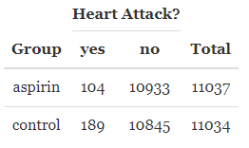
Heart Attacks and Aspirin
A large-scale randomized experiment investigated the effect of regular aspirin use on myocardial infarctions (i.e., heart attacks).
What is the response and explanatory variable?
Are these samples independent or dependent?
What is one question we may be interested in testing ?

